Slide 1
Finding Structural Variants using different SVcallers.
Details about the flow of the pipeline.

Slide 2
Content
Aim/Goal.
Introduction to SV’S.
Structure of the Pipeline.
Tools Used.

Slide 3
Aim:
To filter out the large structural variants in the bovine genomes available at SLU(Planet Smasher).

Slide 4
Introduction to SV’s.
Structural variants are genomic rearrangements larger than 50 bp accounting for around 1% of the variation among human genomes.
Structural variation (SV) is generally defined as a region of DNA approximately 1 kb and larger in size and can include inversions and balanced translocations or genomic imbalances (insertions and deletions), commonly referred to as copy number variants (CNVs).

Slide 5
Introduction to SV’s
Variants, which are ~ 3 Mb or more in size, are referred as microscopic structural variants.
Variants, which are ~ 1kb to 3 Mb in size, are referred as sub-microscopic structural variants.
Sub-microscopic structural variants, despite their smaller size, their overall potential contribution to human genetic variation and disease might be expected to be higher than for microscopic variants, as they seem to occur at a higher frequency.

Slide 6
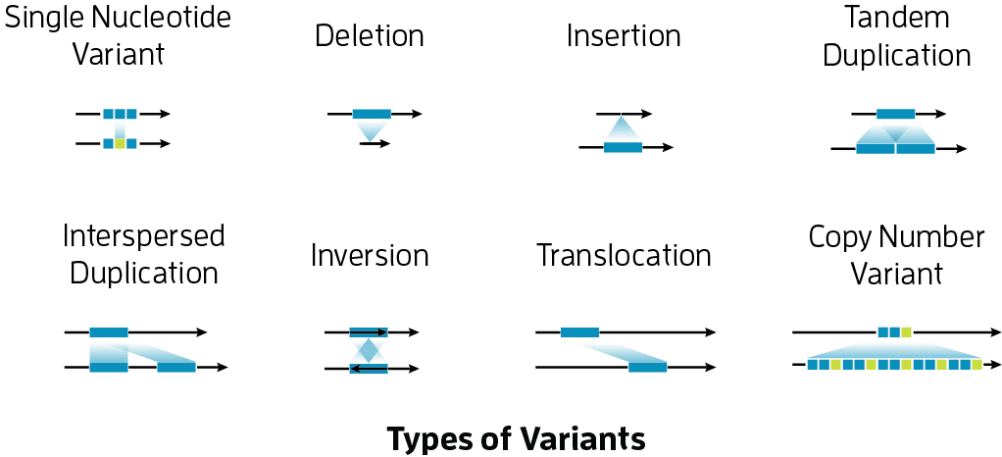
Classes of SV:
CNV(Copy number variation):
Deletions.
Duplications.
CNR(Copy neutral rearrangements):
Inversions.
Translocations.
Other SV’s:
Novel insertions.
Mobile-element transposition.

Slide 7
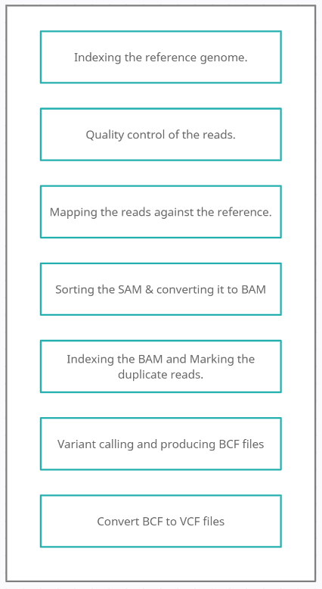
SV Pipeline:
BWA-MEM for indexing and mapping the reads against REF.
FastQC and fastp for quality control of the reads.
Samtools for stats and file conversions
Picard and GATK for marking duplicates and base reads recalibration.
Variant calling using several tools based on different strategies.

Slide 8
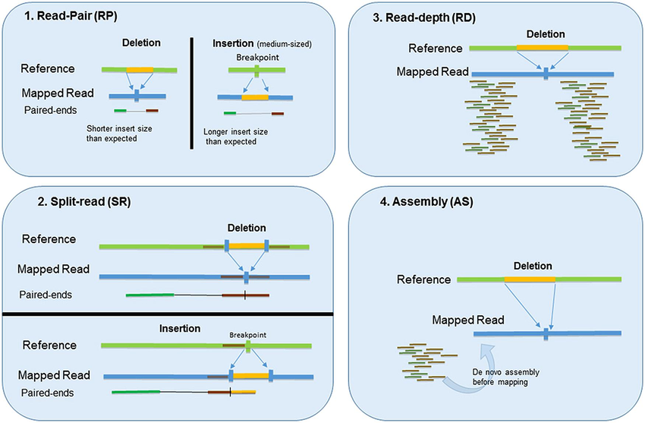
SV strategies:
Various kinds of strategies used by different set tools to call structural variants.
Reference: Pirooznia, Mehdi & Goes, Fernando & Zandi, Peter. (2015). Whole-Genome CNV Analysis: Advances in Computational Approaches. Frontiers in Genetics. 06. 10.3389/fgene.2015.00138

Slide 9
Tools used:
SVcallers :
Manta.
BREAKDANCER.
Delly.
CNVnator.
ABySS.
HipSTR74.
QC :
Fastp.
FastQC.
Other :
Samtools.
BWA.
Bcftools.
Picard.
GATK.
SVprops.
Platform : Nextflow programming and Bash scripting.

Slide 10
Extended use of these SV’s.
Mapping these genotypes to their phenotypes gives us better understanding of then cattle.
These structural variants are further used to build GRAPH GENOMES, which tend to perform better than the linear reference genomes.
The outcome of this pipeline can be used as a pilot test for determining the effect size which is essential for the power analysis.
Can be used to create a precise Structural variants data for future purposes.

